Slide 1


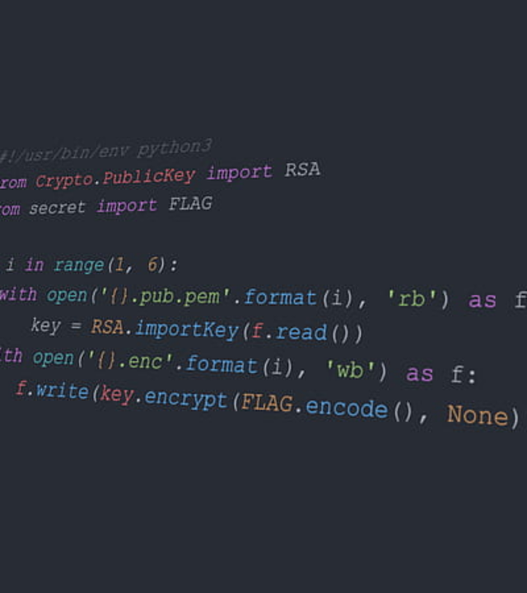
FITNESS TRACKING
ONE PAGE PROJECT OBJECTIVE
Develop a Centrally Automated Health System: To build a robust console-based application using Python that structures user data lifecycle from registration to daily metrics logging without system dependencies.
Automate Health Metric Diagnostics: To design a real-time computation utility that automatically calculates critical indices like BMI and assigns immediate health classifications based on user profile inputs.
Establish Persistent Structural Storage: To implement lightweight, file-based engines using structured CSV files for handling profile/activity data datasets and JSON models for target metrics.
Incorporate High-Performance Data Analytics: To utilize Pandas DataFrames to accurately query, clean, and process historical logs into structural aggregate insights (such as weekly step-counts or caloric deficits).
Integrate Cognitive AI Coaching: To securely embed the Groq LLM API to parse structured tracking metrics and distribute predictive fitness advice, automated routine validations, and motivational messaging.
Optimize Navigation and Inputs: To program an intuitive, numeric-based command terminal interface that eliminates validation exceptions and simplifies navigation across modules.
Build a Scalable Foundation: To create a clean, decouple-modular architecture that satisfies short-term console requirements while providing an integration-ready backend for a future GUI or cloud sync.

